Slide 1
Reservoir Simulator
Dalton Gilpatrick
December 4, 2017

Slide 2
Accomplishments
Functions completed: Porosity, FVF, Accumulation, Transmissivity
Jacobian assembled, but there are likely bugs
Residual assembled, but there are likely bugs

Slide 3
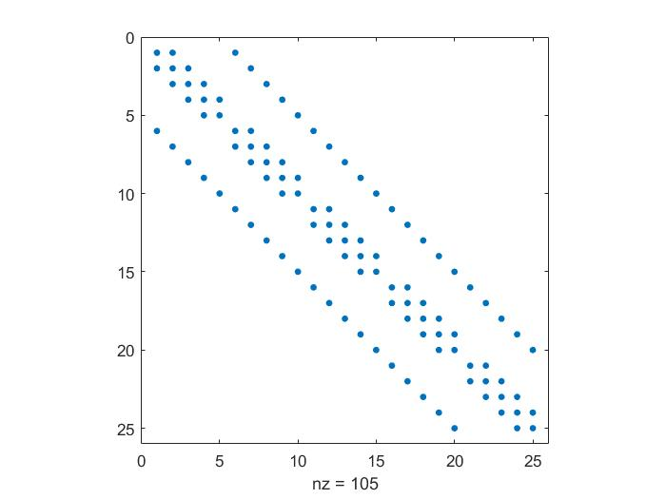
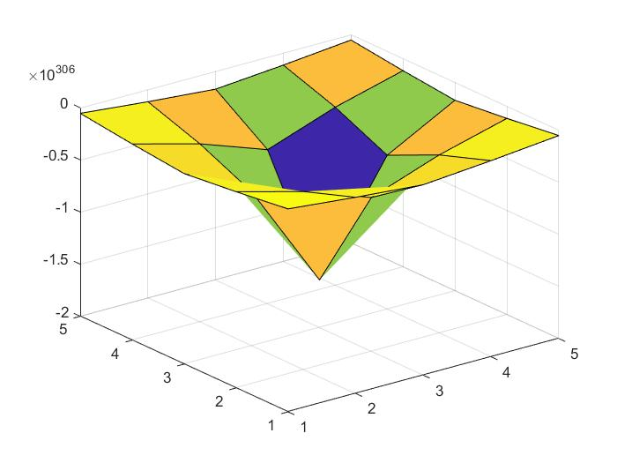
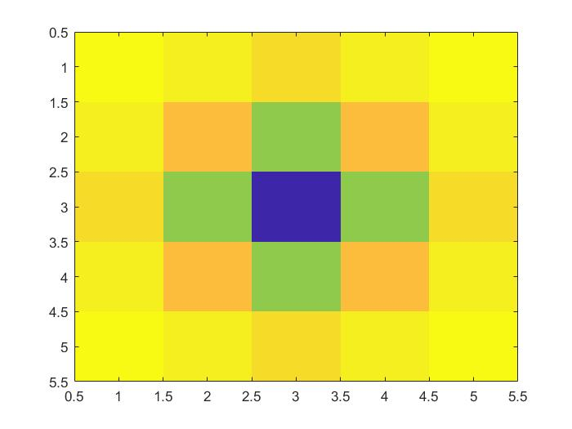
Current Outputs

Slide 4
Tasks to Complete
Complete and correct Newton iteration process
Debug Jacobian and Residual calculations
Ensure convergence in a timely manner
Add additional bells and whistles if time allows

